Slide 1
Stoichiometry
Chem 332 – O’Dette

Slide 2
What is stoichiometry?
Stoich allows us to predict the amounts of product produced or reactant needed in a reaction

Slide 3
Law of Conservation of Mass
No change in total mass occurs in a reaction.
Mass of products is equal to mass of reactants.

Slide 4
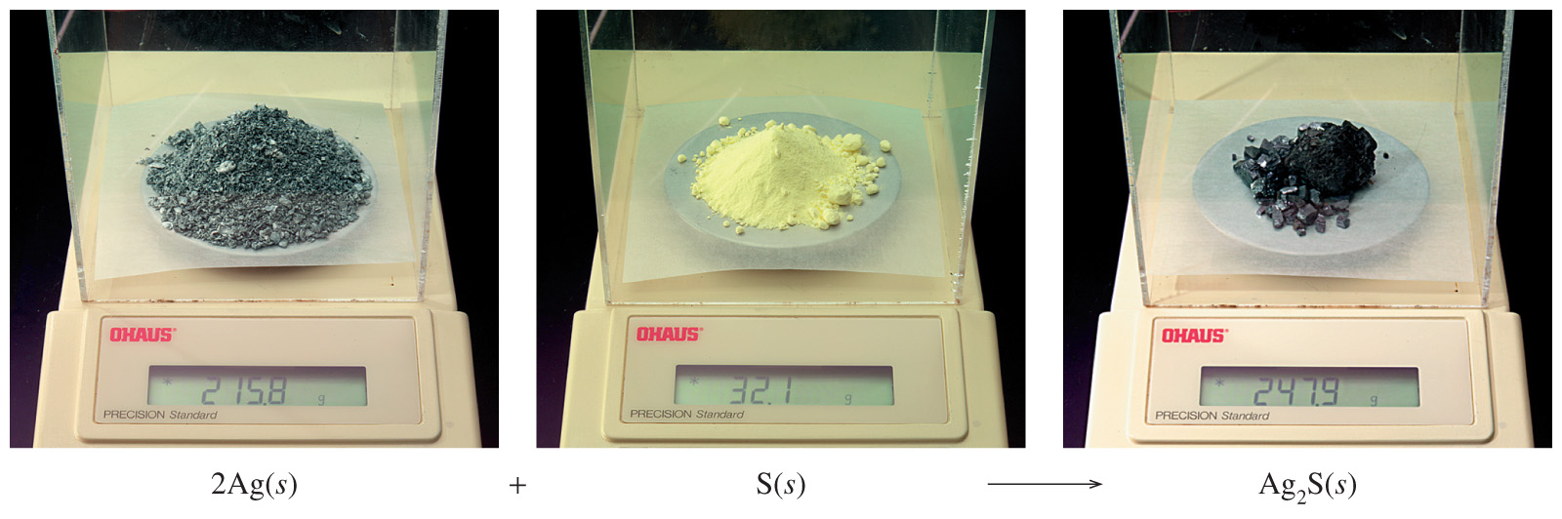
Conservation of Mass
2 mole Ag + 1 mole S = 1 mole Ag₂S
2 (107.9 g) + 1(32.07 g) = 1 (247.9 g)
247.9 g reactants = 247.9 g product

Slide 5
Mole Ratio
A conversion factor that relates the amounts in moles of any two substances in a reaction.
Use the coefficients in a balanced equation.

Slide 6
Mole Ratios Conversion Factors
Balance the following equation
___ NH₃ + ___ O₂ ___ NO + ___ H₂O
Examples of Mole Ratios
4 moles NH₃
4 moles NO
5 moles O₂
6 moles H₂O
4 moles NO
6 moles H₂O
Remember Reciprocals!!!
4
5
4
6
There are a total of 6 mole ratios for this equation!!!

Slide 7
Steps to Solving Stoich Problems
Write a correctly balanced chemical equation.
If you are given moles proceed to step 3, otherwise convert to moles. If you are given
Mass, use molar mass
Volume, use molarity
Particles, use Avogadro’s number
Convert using a mole ratio into the moles of the substance that you are asked to find.
If the problem asked to find moles stop here. If it asked to find mass, volume, or molecules convert using the appropriate conversion factor.

Slide 8
Mole to Mole
Example #1: If we have 12 moles of Al₂O₃, how many moles of Al and O₂ are produced?
2 Al₂O₃ 4 Al + 3 O₂
12 moles Al₂O₃ x
12 moles Al₂O₃ x
4
moles Al
=
24 moles Al
2
moles Al₂O₃
3 moles O₂
18 moles O₂
=
2 moles Al₂O₃

Slide 9
Mole to Mass
Example #2 : How many grams of chlorine are required to react completely with 5.00 moles of sodium to produce sodium chloride?
2 Na + Cl₂ 2 NaCl

Slide 10
Example #2 (continued)
2 Na + Cl₂ 2 NaCl
Plan: Moles Na
Use Mole Ratio
5 moles Na x x
Moles Cl₂
Mass Cl₂
Use MM
1 mole Cl₂
70.90 g Cl₂
2 moles Na
1 mole Cl₂
Use the mole ratio to convert to the substance asked for
Mole Ratio
MM
= 177 grams Cl₂

Slide 11
Mole to Volume
Example #3: Sulfuric acid, H₂SO₄, reacts with calcium hydroxide in a double replacement reaction. What volume of 5 M H₂SO₄ would be needed to produce 3 moles of water?
H₂SO₄ + Ca(OH)₂ CaSO₄ + 2H₂O

Slide 12
Example #3 (continued)
H₂SO₄ + Ca(OH)₂ CaSO₄ + 2H₂O
Plan: Moles H₂O
Use Mole Ratio
3 moles H₂O x
Moles H₂SO₄
L of H₂SO₄
Use Molarity
1 mole H₂SO₄
1 L H₂SO₄
X
2 moles H₂O
5 moles H₂SO₄
= 0.3 L H₂SO₄
Use the molarity to convert to volume

Slide 13
Volume to Mole
Example #4: When 500. mL of 2 M Na₃PO₄ is reacted with excess BaCl₂, how many moles of sodium chloride would be formed?
2 Na₃PO₄ + 3 BaCl₂ 6 NaCl + Ba₃(PO₄)₂

Slide 14
Example #4 (continued)
Plan: L Na₃PO₄ Moles Na₃PO₄ Moles NaCl
Use Molarity Use Mole Ratio
.500 L Na₃PO₄ x
2 moles Na₃PO₄
6 moles NaCl
X
1 L Na₃PO₄
2 moles Na₃PO₄
= 3 moles NaCl

Slide 15
Molecule to Mole
Example #5 - Calculate the number of moles of ethane (C₂H₆) needed to produce 2.0x10²⁵ molecules of water in a combustion reaction.
2 C₂H₆ + 7 O₂ 6 H₂O + 4 CO₂

Slide 16
Example #5 (continued)
1 mole H₂O
x
2 moles C₂H₆
2x10²³ molecules H₂O x
6.022x10²³ molecules H₂O
6 moles H₂O
Use AN instead of MM to convert to moles
= 0.111 moles C₂H₆

Slide 17
Example #6
Tin(II) fluoride, SnF₂, is used in some toothpastes it is made by the reaction of tin with hydrogen fluoride according to the following equation.
Sn + 2 HF SnF₂ + H₂
How many grams of SnF₂ are produced from the reaction of 30.00 g HF with Sn?

Slide 18
Example #6 (continued)
Sn + 2 HF SnF₂ + H₂
Plan: Mass HF
Use MM
30 g HF x x x
Moles HF
Moles SnF₂
Mass SnF₂
Use Mole Ratio
Use MM
1 mole HF
1 mole SnF₂
156.71 g SnF₂
20.00 g HF
2 moles HF
1 mole SnF₂
MM
Mole Ratio
MM
= 117.5 g SnF₂

