Slide 1
CRIME SCENE PROCESSING
Forensics 352 – O’Dette

Slide 2
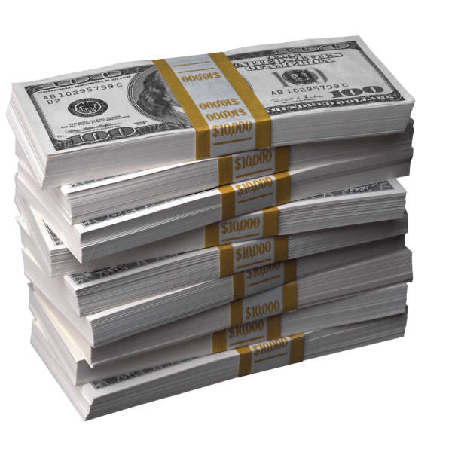
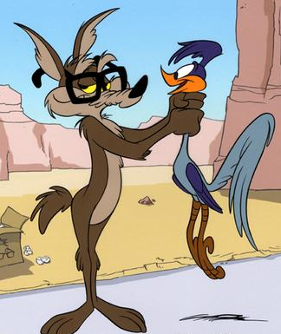
The Crime
What are the top reasons for committing a crime?
Money
Revenge
Emotion – love, hate, anger

Slide 3
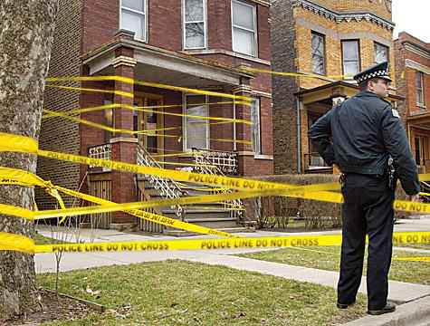
POST – Crime Scene Investigation
Protect the Scene
Observe (notes/photo/sketch)
Search & Secure (evidence)
Take (evidence)

Slide 4
Crime Scene Team
Team Members:
First Police Officer on the scene
Lead Investigator
Field Evidence Technicians
Photographer
Evidence Recorder/Collector
Medical Examiner & Medics (if necessary)
Lab Experts

Slide 5
Protect the Scene
Duties of 1st Responding Officer
Check safety of scene (control threats)
Tend to the injured
Separate witnesses and suspects
Secure the scene
Barricade boundaries
Exclude unauthorized personnel

Slide 6
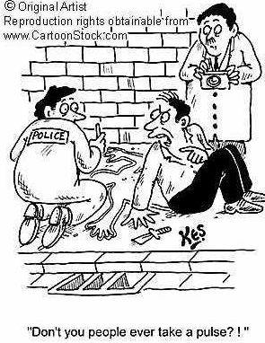

Slide 7
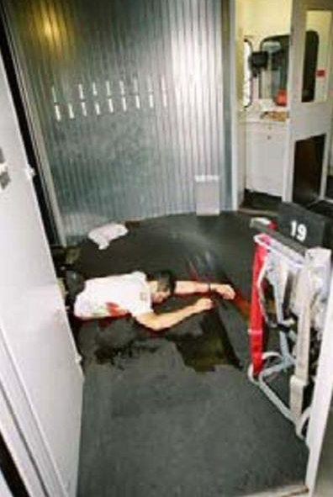
Observe the Scene
Initial Walk Through
performed by lead investigator & field evidence technicians
establish safe route through scene, no disturbance to evidence!!!!

Slide 8
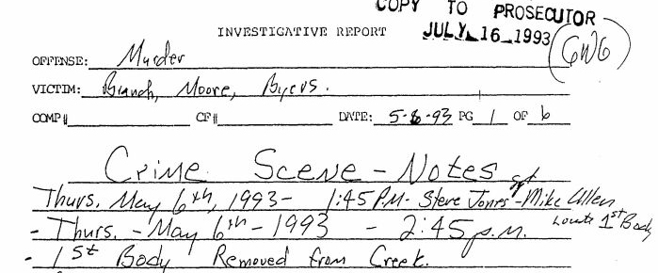
Documentation
1. Notes
The following should be included in notes:
-Date -Location of crime
-Time -Weather conditions
-Description of crime -Location of evidence
-Names of all people involved – Points of entry/exit
-Type of Scene

Slide 9
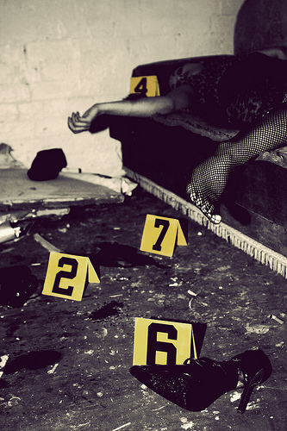
Documentation
2. Photography
Each photo must be numbered and written down in a photo log
No person should be in any photo except a dead body (or bodies)
Place evidence numbers to mark the location of evidence

Slide 10
Documentation
2. Photography
Photos should include:
Overall view of scene
At various angles
Include near by areas
Evidence
Start with general photos and get more detailed
Include rulers for scale (if size is significant)
Videography can also be used with narration.

Slide 11
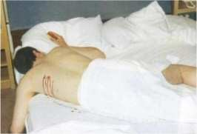
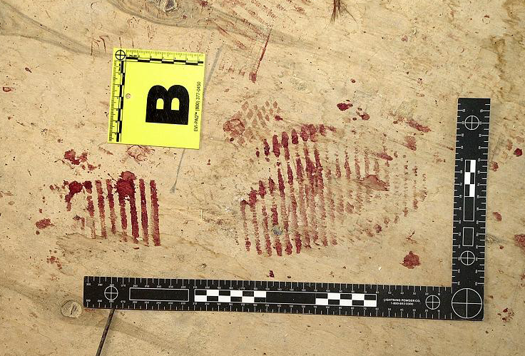
Photography

Slide 12
Documentation
3. Sketches
Done after photos are taken
Used to supplement photos
Rough Sketch
drawn at the crime scene
contains an accurate depiction of the dimensions of the scene
Finished Sketch
precise rendering of the crime scene
drawn to scale

Slide 13
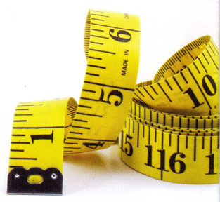
Documentation
Measurement Method – Baseline
Choose a reference point and line
Locate items based on their distance and compass direction in relation to reference
Record distances in a measurement reference table

Slide 14
Documentation
3. Sketches (continued)
Rough Sketches MUST include:
Dimensions of rooms, furniture, doors, & windows
Evidence
Date, time, location, sketchers name, case number
Show a compass heading designating north a top of sketch

Slide 15
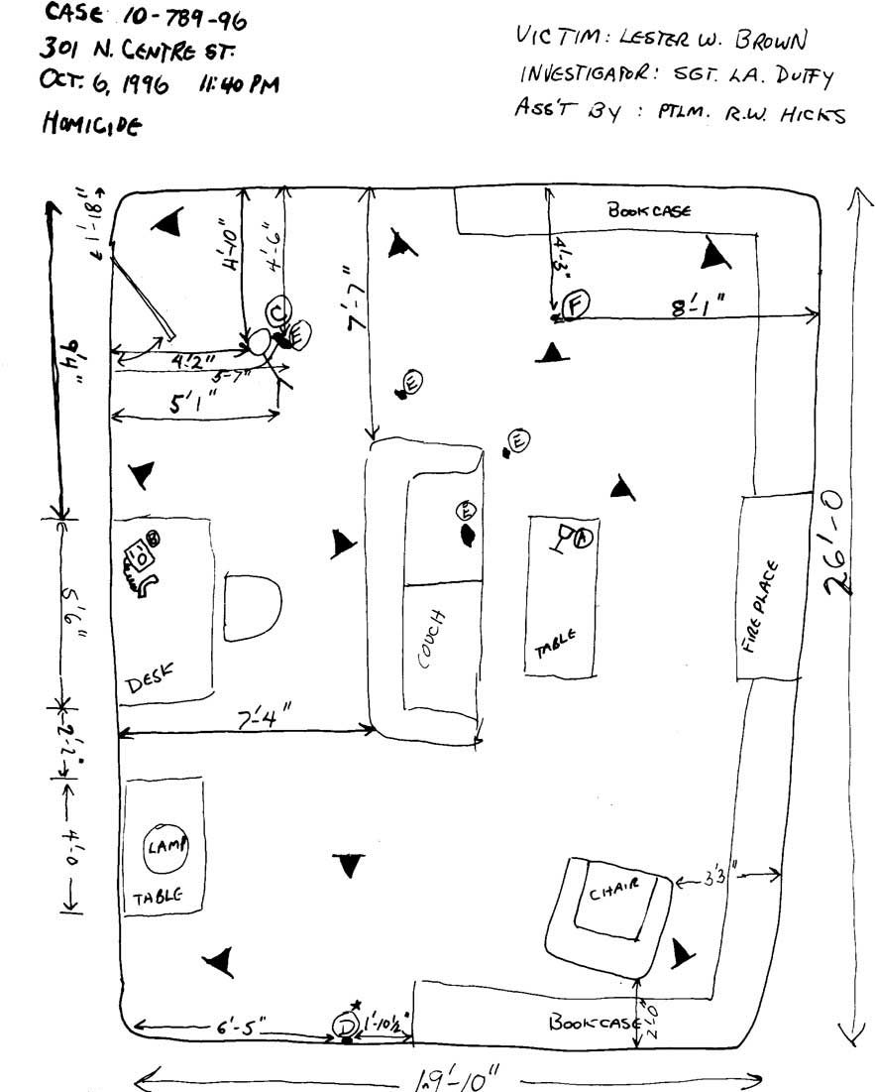
Rough Sketch
Hand drawn with notes.

Slide 16
Documentation
3. Sketches (continued)
Final Sketches MUST include:
All features listed for rough sketch
Legend
Assign each item a number or letter and list it in the legend.
Scale

Slide 17
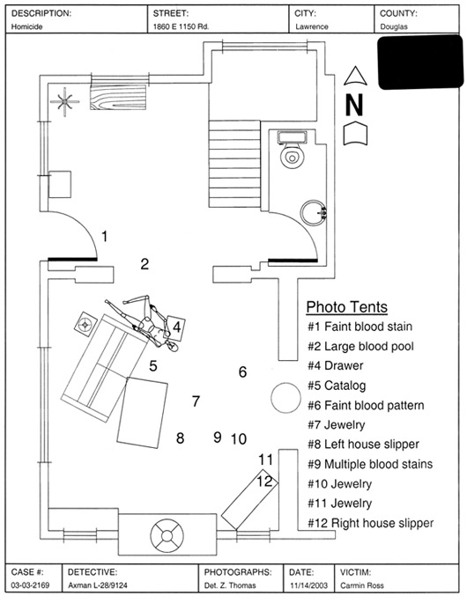
Final Sketch
Computer-aided drafting (CAD) is often used.

Slide 18
Search & Secure Evidence
Grid method—basically a double-line search (effective, but time-consuming).
Line or strip method—best in large, outdoor scenes.
Zone method—most effective in houses or buildings (teams are assigned small zones for searching).
Spiral method—may move inward or outward (best used where there are no physical barriers).

Slide 19
Systematic Search Methods

Slide 20
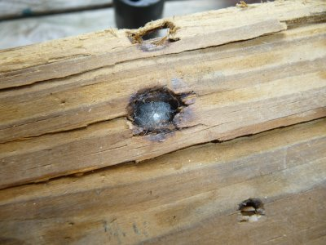
Taking Evidence
Only one individual should be the evidence collector.
Each item must be placed in a separate container, sealed, and labeled with date of collection + location of evidence.
Most fragile is collected and packaged first.
If evidence is lodged in a larger structure, part of that structure should be removed with the evidence.

Slide 21
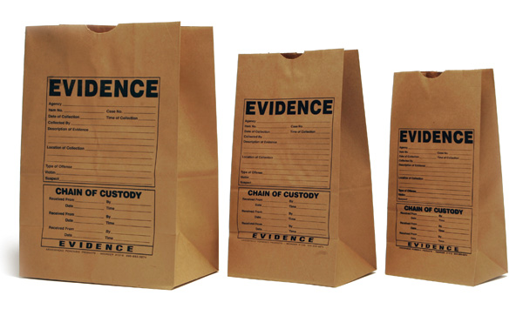
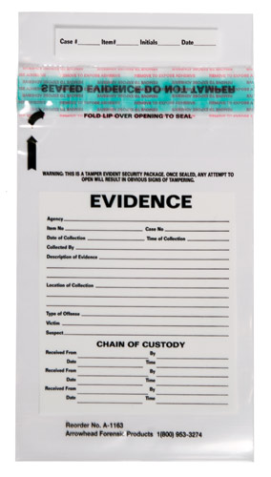
Taking Evidence
Items should be placed inside containers such as paper bags, plastic bags, canisters, packets and envelopes depending on the type and size of the evidence.
*Everything must be properly logged!!!

Slide 22
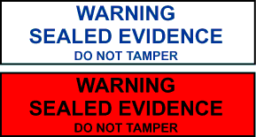
Taking Evidence
Chain of Custody = A written record of all people who have had possession of an item of evidence.
The collector’s initials should be placed on the seal.
If evidence is turned over to another person, the transfer must be recorded.

Slide 23
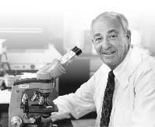
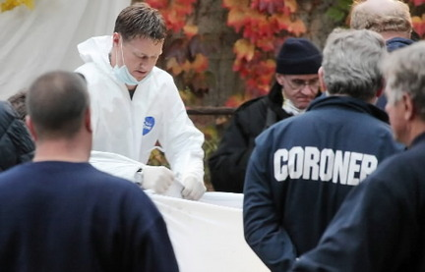
Medical Examiner vs Coroner
A medical examiner is a medical doctor, usually a pathologist and is appointed by the governing body of the area. There are 400 forensic pathologists throughout the U.S.
A coroner is an elected official who usually has no special medical training. In four states, the coroner is a medical doctor.
Cyril Wecht

Slide 24
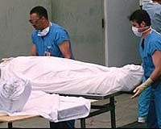
Autopsy
The medical examiner carefully examines the victim to
Identify the deceased
Establish the time and date of death
Determine a cause of death
Classify the manner of death (Natural, Accidental, Suicide, Homicide, Undetermined)
Notify the next of kin

