Slide 1
Chemical Reactions
Chem 332 – O’Dette

Slide 2
Chemical Equation
yield
Reactants Products

Slide 3
Symbols/States of Matter
= heated
(s) = solid
(l) = liquid
(g) = gas
(aq) = aqueous ; substance is dissolved in water
catalyst = accelerates a chemical reaction

Slide 4
Balanced Equations
A equation must have the same number of atoms on each side of the equation
Equations are balanced by using coefficients
3 O₂
Coefficient
Subscript

Slide 5
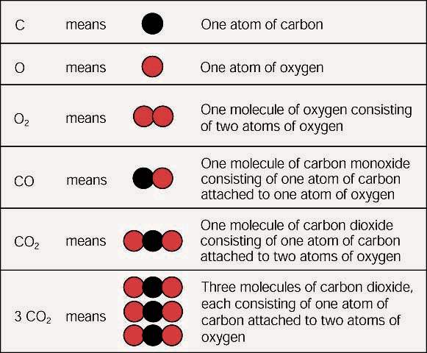
Subscript vs. Coefficient

Slide 6
Steps for Balancing Equations
Example: Write the balanced equation and states of matter for the reaction of magnesium + aqueous silver nitrate to yield aqueous magnesium nitrate + silver
Write the equation using the correct formula
Mg (s)
+
AgNO₃ (aq)
Mg(NO₃)₂ (aq)
+
Ag (s)

Slide 7
Steps for Balancing Equations
Determine if the equation is balanced
**Keep polyatomics together if they are on both sides of the equation
Mg (s) + AgNO₃ (aq) Mg(NO₃)₂ (aq) + Ag (s)
R(reactants) P(products)
1
Mg
1
Mg
Balanced
1
Ag
1
Ag
Balanced
1
NO₃
2
NO₃
Not Balanced

Slide 8
Steps for Balancing Equations
Balance one element/polyatomic at a time using coefficients
****Balance O and H last!!!!
Mg (s) + AgNO₃ (aq) Mg(NO₃)₂ (aq) + Ag (s)
2
2

Slide 9
Steps for Balancing Equations
Check to see if balanced
R P
1 Mg 1 Mg
2 Ag 2 Ag
2 NO₃ 2 NO₃
Balanced
Balanced
Balanced

Slide 10
Example
Write the equation and states of matter for the reaction of oxygen and aluminum to yield solid aluminum oxide
O₂ (g) + Al (s) Al₂O₃ (s)
3 O₂ (g) + 4 Al (s) 2 Al₂O₃ (s)

Slide 11
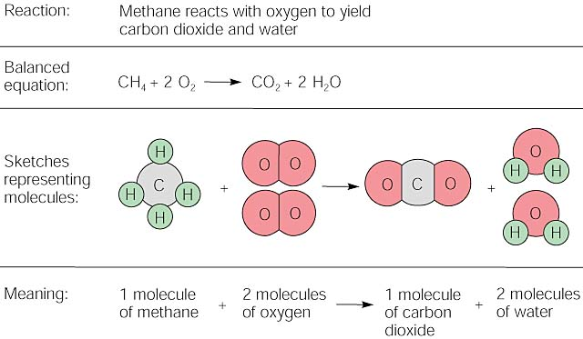

Slide 12
Common Mistakes
Changing subscripts (DO NOT CHANGE SUBSCRIPTS)
Forgetting diatomics (HOBrFINCl or Big 7)

