Slide 1
Chemical Formula Notes
Chemistry 332 – O’Dette

Slide 2
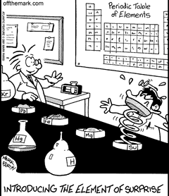
What is a formula?
Describes the number and kinds of atoms or ions that make up a compound

Slide 3
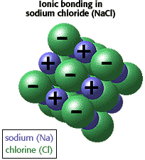
Ionic Compounds
The sum of the ionic charges in the formula is always zero.

Slide 4
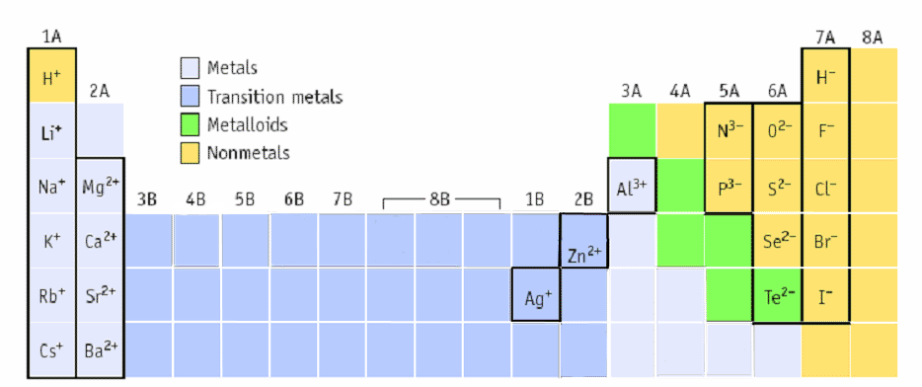
We learned how to find ionic charges of most elements based on what group they are in.
+1 +2 +3 -3 -2 -1 0
Cd⁺²

Slide 5
Binary Ionic Compounds
Three types of ionic compounds
Binary = composed of only two different elements
How to Name
Metal ions are always written first and keep their elemental name.
For nonmetal ions the end of the elemental name is changed to –ide.
Example: chlorine chloride

Slide 6
Binary Ionic Compounds
How to Write Formulas
Determine individual charge of each the cation and the anion
Determine how many atoms of each element are in the compound to balance charge

Slide 7
Binary Ionic Compound
Ex: What is the formula for a compound containing the following ions, calcium and fluorine?
F¹⁻
CaF₂
Ca²⁺
+
F¹⁻

Slide 8
Variable Charge Ionic Compound
Variable Charge = compound contains cation that does not always have the same charge
Transition metals except Cd, Zn, and Ag exhibit variable charge
Other metals such as Pb and Sn exhibit variable charge

Slide 9
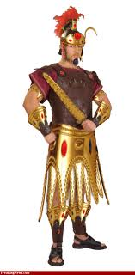
Variable Charge Ionic Compounds
How to Name
Same rules as binary, but include roman numeral
Roman numerals in parentheses represent the charge of the ion
Example : lead (IV) = Pb⁴⁺
Use the known charge of anion to determine charge of cation

Slide 10
Variable Charge Ionic Compounds
Ex: Write the name for Au₂S
Au? + S²⁻
charge balance 2(?) + (2-) = 0
2(1+) + (2-) = 0
gold (I) sulfide

Slide 11
Variable Charge Ionic Compounds
How to Write Formulas
Use same rules as binary
Ex: Write the formula for copper (II) iodide
I¹⁻
CuI₂
Cu²⁺
I¹⁻

Slide 12
Polyatomic Ionic Compounds
Polyatomic = individual ions containing more than one element
How to Name
Look up the charge on Ion Chart

Slide 13
Polyatomic Ionic Compounds
How to Name(cont.)
Cation
If it is an element, use element name
If it is a polyatomic, use name of ion
Anion
If it is an element, use element name with “ide”
If it is polyatomic, use name of ion

Slide 14
Polyatomic Ionic Compounds
Examples
Ba(OH)₂
Barium hydroxide
NH₄S
Ammonium sulfide

Slide 15
Polyatomic Ionic Compounds
How to Write Formulas
Use same rules as binary
Use parenthesis when there is more than one polyatomic ion

Slide 16
Polyatomic Ionic Compounds
Ex: aluminum sulfate
Al₂(SO₄)₃
SO₄²⁻
Al³⁺
SO₄²⁻
Al³⁺
SO₄²⁻

Slide 17
Learning Check
Name the following compounds
Na₃N
FeCl₂ *
Zn₃(PO₄)₂
(NH₄)₂NO₂
*don’t forget about transition metals
sodium nitride
iron(II) chloride
zinc phosphate
ammonium nitrite

Slide 18
Learning Check
Write the formula for the following
Potassium oxide
Silver (I) sulfide
Mercury (II) sulfate
Lithium thiocyanate
K₂O
Ag₂S
HgSO₄
LiSCN

Slide 19
Covalent Compounds
Memorize and use these prefixes
1-
2-
3-
4-
5-
6-
7-
8-
9-
10-
mono
hexa
di
hepta
tri
octa
tetra
nona
penta
deca

Slide 20
Covalent Compounds
How to Name
Use prefix before first element, unless it is mono
Use element name of first element
Use prefix before second element, no exceptions
Use element name of second element with “ide” ending

Slide 21
Covalent Compounds
Ex: CO₂
carbon dioxide
How to Write Formulas
Use prefixes to determine how many of each element are in compound
Ex: dinitrogen monoxide
N₂O

Slide 22
Learning Check
Write the name of the following compounds
SbI₄
P₂Cl₃
CO
antimony tetraiodide
diphosphorus trichloride
carbon monoxide

Slide 23
Learning Check
Write the formula for the following
arsenic tribromide
carbon tetrachloride
diphosphorus pentasulfide
AsBr₃
CCl₄
P₂S₅

